Slide 1

DATA ANALYSIS
CRIMES IN INDIA

Slide 2
TOOLS USED
1 | 2 | 3 | 4
MICROSOFT SQL | SEABORN | MATPLOTLIB | PANDAS

Slide 3
CRIMES IN INDIA
An action or omission which constitutes an offence and is punishable by law.
'an offence which goes beyond the personal and into the public sphere, breaking prohibitory rules or laws, to which legitimate punishments or sanctions are attached, and which requires the intervention of a public authority. '

Slide 4
FACTORS AFFECTING CRIMES
POVERTY
DRUGS
RELIGION
POLITICS
UNEMPLOYMENT
UNFAIR JUDICIAL SYSTEM
FAMILY CONDITIONS

Slide 5
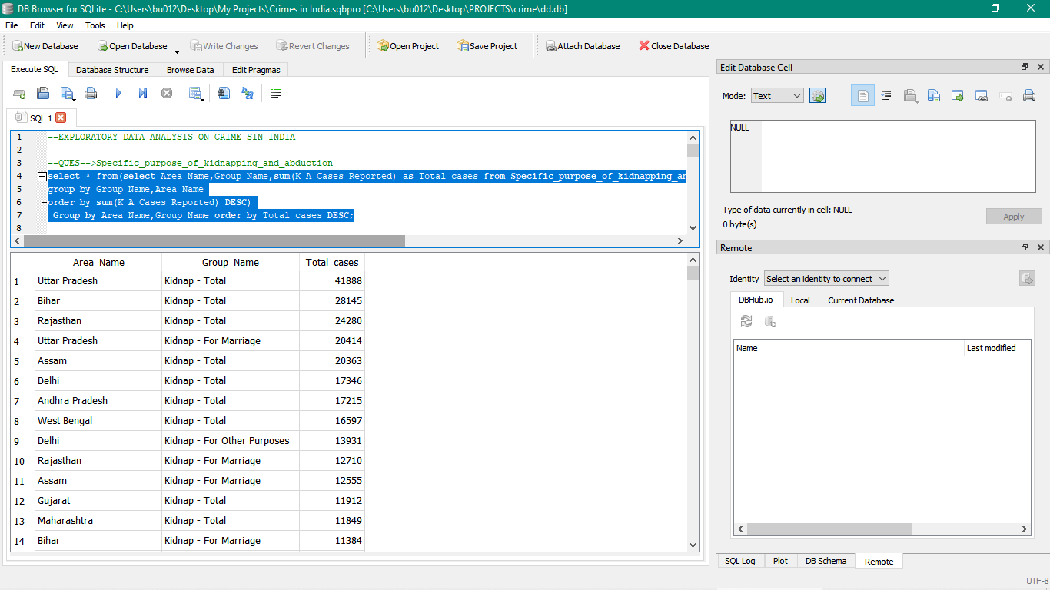
What is the major reasons people being kidnapped in each and every state?

Slide 6
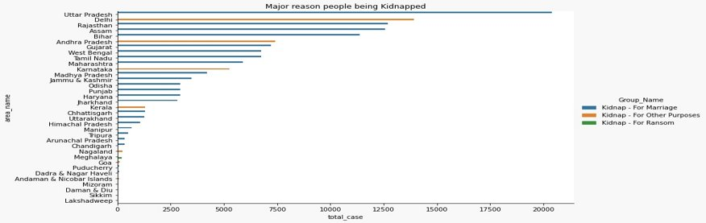
Uttar Pradesh have the major cases of kidnapping.

Slide 7
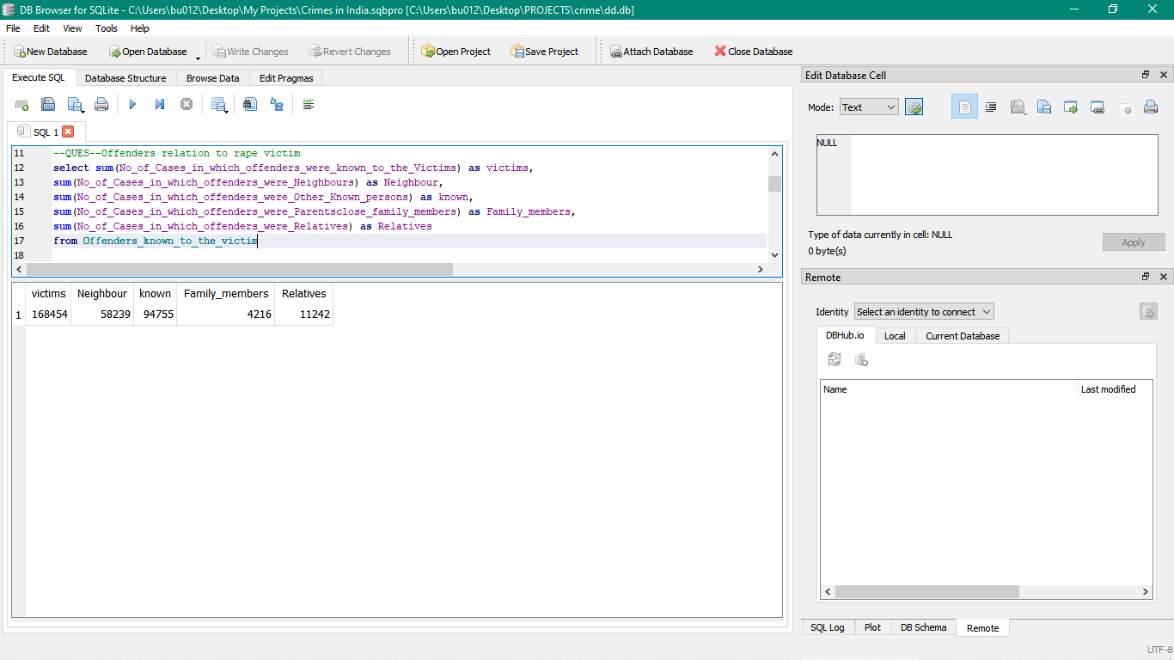
Offenders relation to rape victim

Slide 8
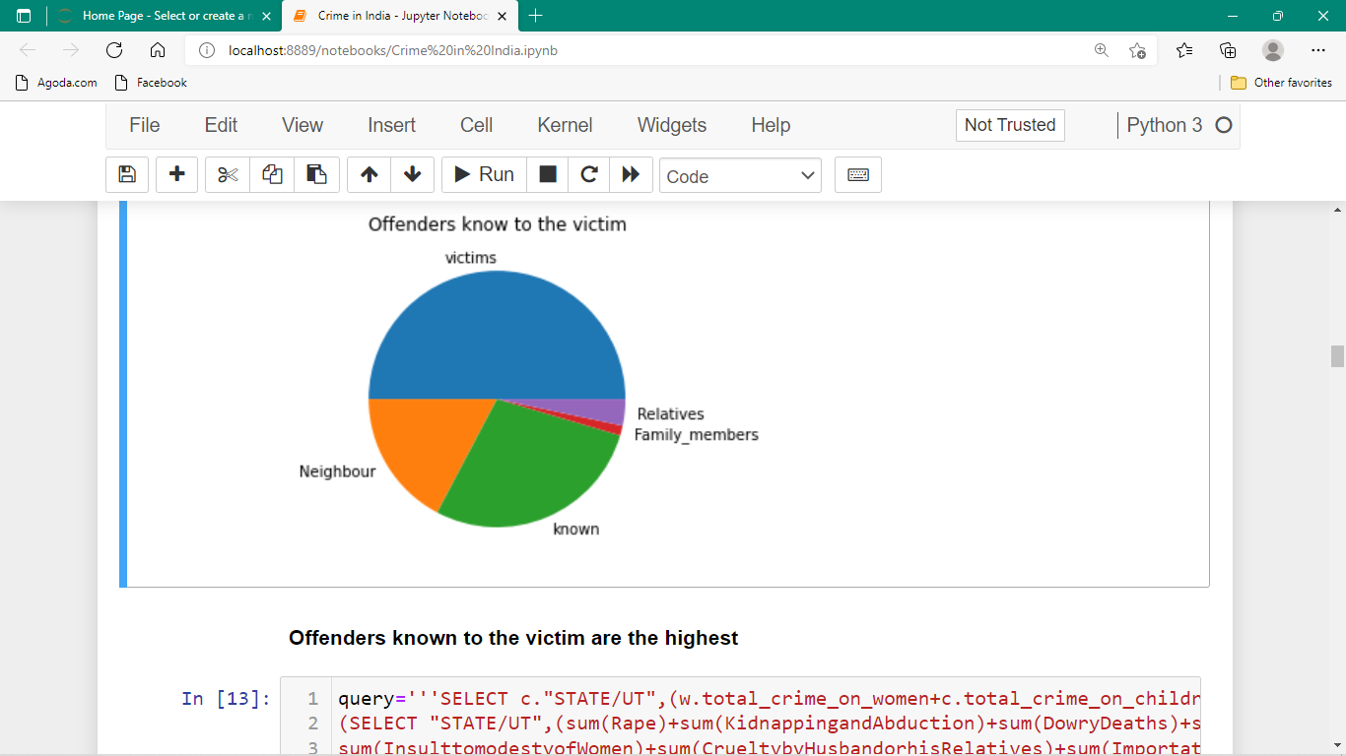
As per the above observation most number of offenders were known to victims with number as high as 168454 and in the second place comes the neighbours.​

Slide 9
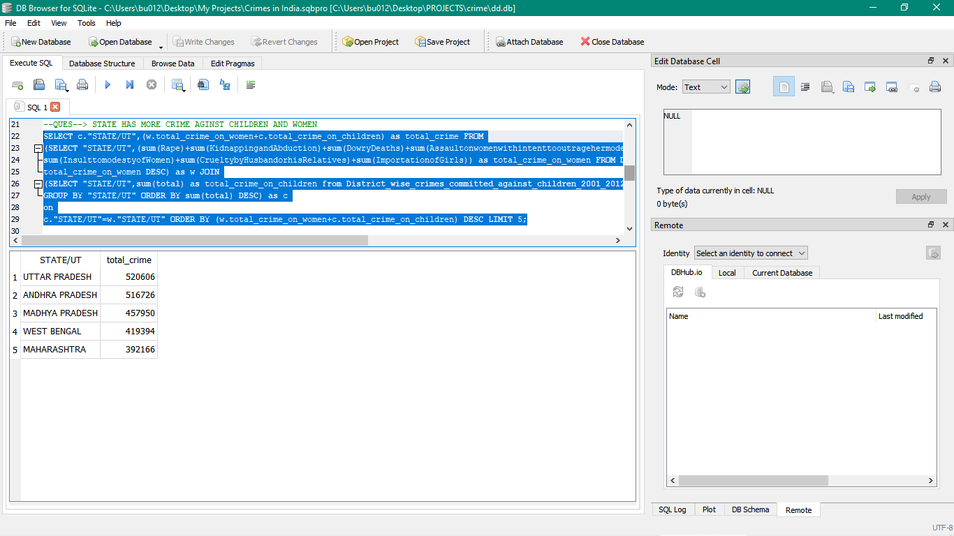
Which state has more crime against children & women?

Slide 10
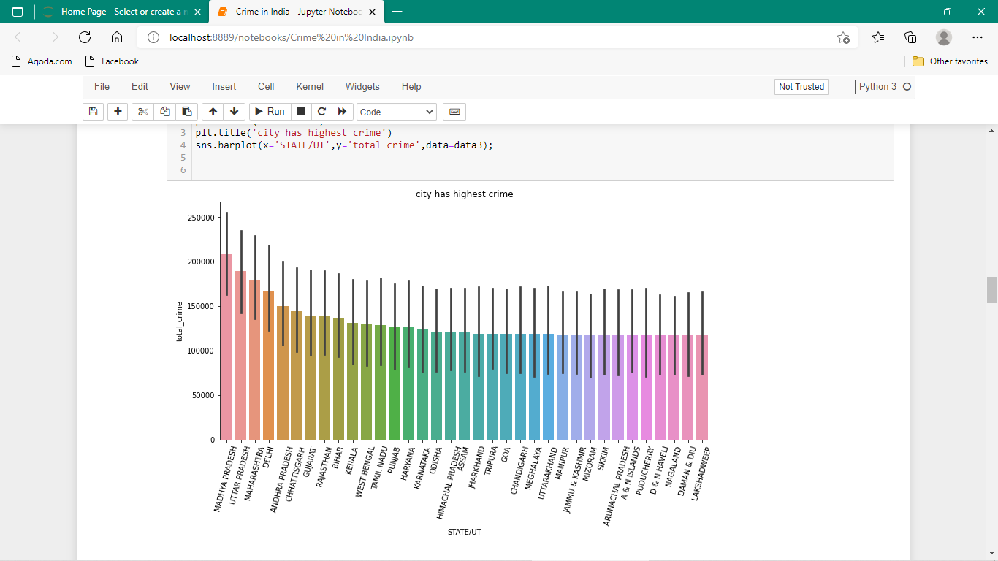
Madhya Pradesh have the highest crime on children and women.

Slide 11
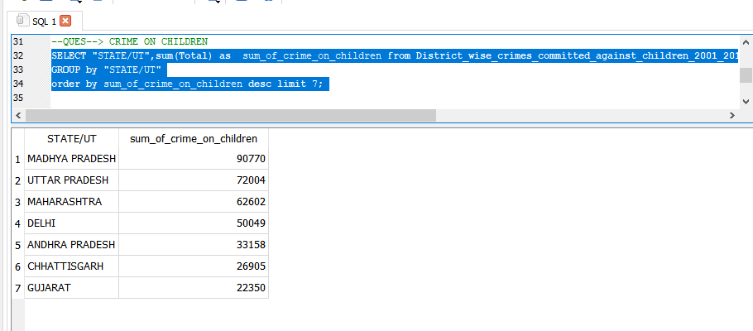
Which State has more crime against children?

Slide 12
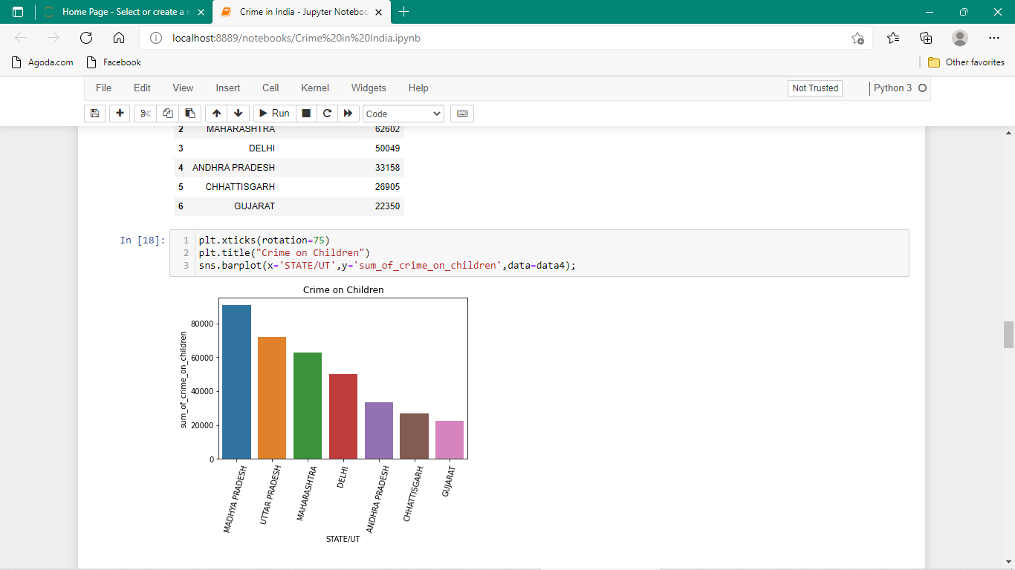
Madhya Pradesh have the highest crime on children.

Slide 13
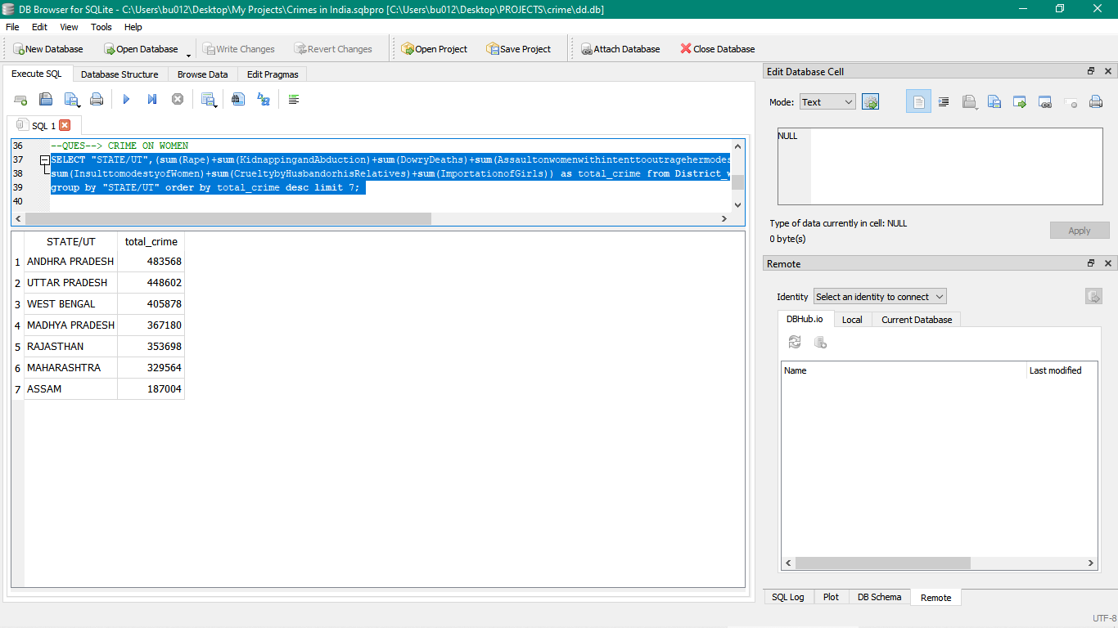
Which state have more crimes on women?

Slide 14
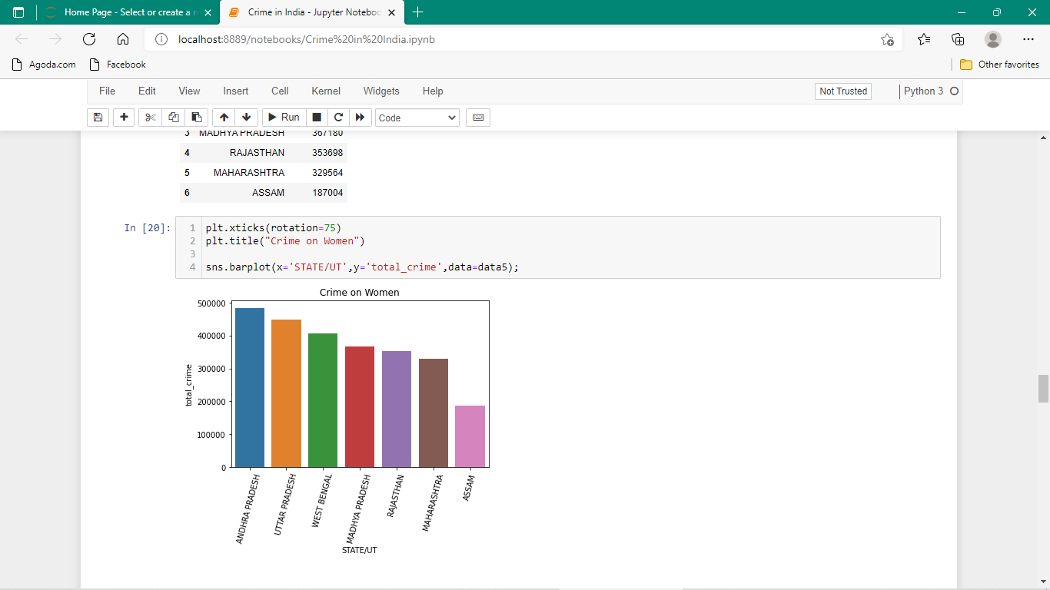
Andhra Pradesh have more crime against women.

Slide 15
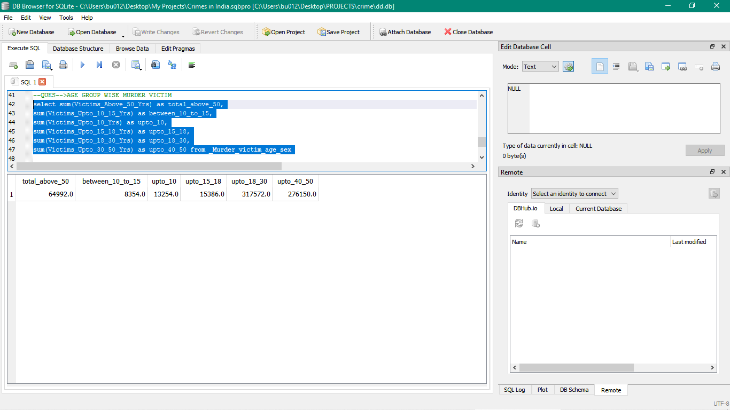
Age group wise murder victim

Slide 16
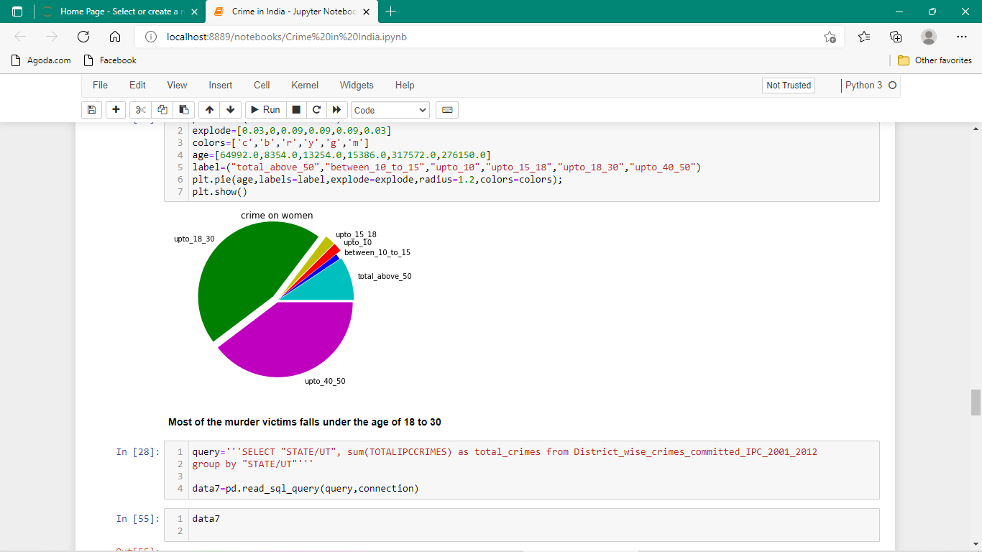
Most murder victims falls in the age bracket of 18 to 30 yrs.

Slide 17
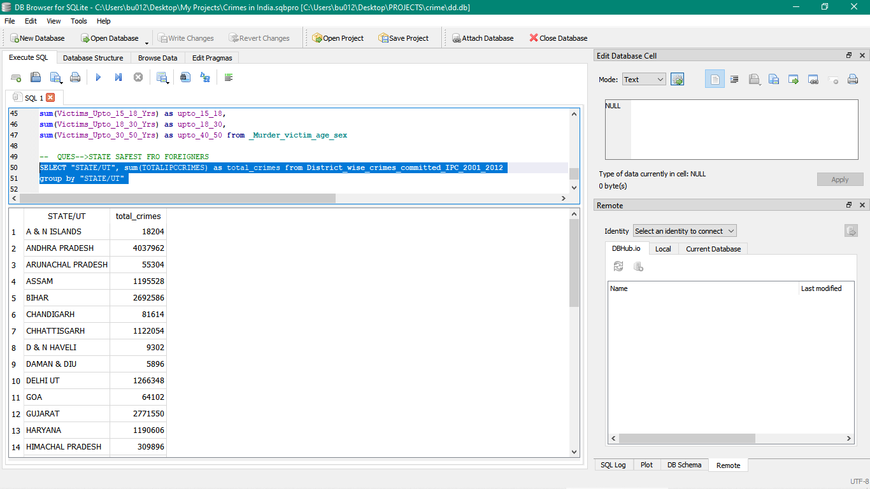
Which state is safest for foreigners?

Slide 18
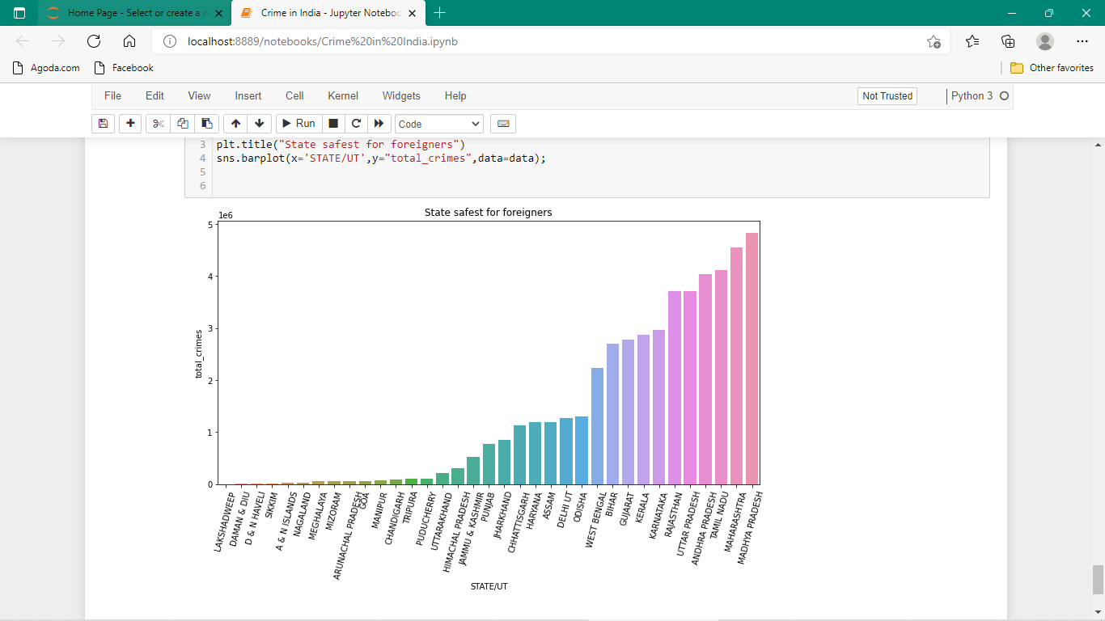
Lakshadweep is the safest territory for the foreigners.

Slide 19
Thank you Presented by Kushagra Mahalwal

